Slide 1



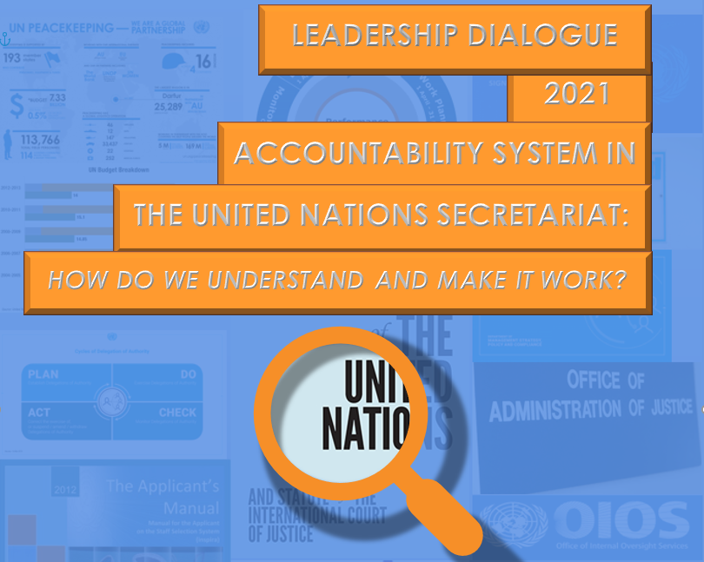


Slide 2
Welcome!
We have collective commitments to the Member States
  to deliver on our mandates
  to deliver on our individual roles as staff members in honouring those commitments.
Understanding the Accountability System in the Secretariat helps us
  make better decisions
  prioritize actions in the public interest
  be ready to answer for the use of the office and resources entrusted to us
Notes:
Welcome to the 2021 United Nations Leadership Dialogue. This annual event is an important opportunity for us to discuss topics with great meaning for our work.
This year’ topic, Accountability System in the United Nations Secretariat: How do we understand and make it work? reminds us of our collective commitments to the Member States as the Secretariat, to deliver on our mandates and our individual roles as staff members in honouring those commitments.
Understanding the Accountability System in the Secretariat in our day-to-day UN operations helps us to make better decisions and prioritize actions in the public interest as well as to be ready to answer for the use of the public office and public resources entrusted to us.

Slide 3
Welcome!
Engage. Please participate and ask questions.
If you do not feel comfortable talking in front of others
  Speak to the session leader after this session
  Speak to the Business Transformation and Accountability Division (BTAD) of the Department of Management Strategy, Policy and Compliance (DMSPC)
  Speak to the Ethics Office.
Other resources
  The Roadmap
  Accountability Handbook - United Nations Secretariat
Notes:
The Secretary-General has asked us to engage in discussions about important ethical issues like this, once a year. So, please participate and ask questions.
If you do not feel comfortable talking in front of others, please speak to me after this session.
If you do not feel comfortable speaking to me, there are many others you can turn to such as the DMSPC/BTAD and the Ethics Office.
Another resource, published by the Ethics Office, is The Roadmap. It is a guide for those seeking assistance and is available on the Ethics Office website.
You may wish to review the booklet Accountability Handbook - United Nations Secretariat.

Slide 4
Welcome!
The Ethics Office and DMSPC/BTAD have developed materials for discussion. UNSU contributed a scenario on accountability for racial bias.
Discussions will start from supervisors to direct supervisees and so on
Today’s discussion overview
  Personal example about an encounter with the Accountability System in the UN Secretariat
  Discussion of two to three scenarios
  Summary
Notes:
Our colleagues at the Ethics Office and at the Business Transformation and Accountability Division (BTAD) of the Department of Management Strategy, Policy and Compliance (DMSPC) have developed materials to guide our discussion. My supervisor has conducted a similar session with me, so I am familiar with the materials. I think you will find them interesting.
Here is an overview of our session today:
We will have an initial discussion about Accountability System in the United Nations Secretariat, using a personal example as a starting point.
Then we will discuss two out of the three scenarios provided. If there is time left, we can tackle the third one.
Finally, we will conclude with a summary of today’s discussions.
Let us get started.

Slide 5
Opening activity
Here is a personal story about a time I faced a situation involving the Accountability System in the Secretariat in my own professional experience …
Notes:
For our first activity, I will share a personal story about a time I faced a situation involving the Accountability System in the Secretariat in my own professional experience.

Slide 6
Opening activity
What key factors are involved in the situation described?
What guidance does the Organization provide to help us in such situations?
Do you see any other potential consequences, both negative and positive?
Notes:
What key factors are involved in the situation described?
What guidance does the Organization provide to help them in such situations?
Do they see any other potential consequences, both negative and positive?
Now, we will discuss today’s specific scenarios, carefully considering how each of us has a role to play in the Accountability System in the United Nations Secretariat.

Slide 7
Introduction to accountability scenarios
The two scenarios we will read today relate to the Accountability System in the United Nations Secretariat.
If there is time left, we will discuss the third.
Each scenario contains different issues interfacing the Accountability System for us to identify and discuss.
First, let us explore the United Nations definition of accountability.
Notes:
The two scenarios we will read today relate to the Accountability System in the United Nations Secretariat. If there is time left, we will discuss the third. Each scenario contains different issues in the Accountability System for us to identify and discuss.
First, let us explore the United Nations definition of accountability.

Slide 8
Introduction to accountability scenarios
“The obligation of the Secretariat and its staff members to be answerable for all decisions made and actions taken by them, and to be responsible for honouring their commitments, without qualification or exception.
Accountability includes achieving objectives and high-quality results in a timely and cost-effective manner, in fully implementing and delivering on all mandates to the Secretariat approved by the United Nations intergovernmental bodies and other subsidiary organs established by them in compliance with all resolutions, regulations, rules and ethical standards; truthful, objective, accurate and timely reporting on performance results and responsible stewardship of funds and resources; all aspects of performance, including a clearly defined system of rewards and sanctions; and with due recognition to the important role of the oversight bodies and in full compliance with accepted recommendations. ”
Paragraph 8, A/RES/64/259 (29 March 2010)
Notes:
On 29 March 2010, the General Assembly agreed on a definition of accountability for the United Nations Secretariat and decided to codify it in its resolution 64/259, paragraph 8 as follows:
“The obligation of the Secretariat and its staff members to be answerable for all decisions made and actions taken by them, and to be responsible for honouring their commitments, without qualification or exception.
Accountability includes achieving objectives and high-quality results in a timely and cost-effective manner, in fully implementing and delivering on all mandates to the Secretariat approved by the United Nations intergovernmental bodies and other subsidiary organs established by them in compliance with all resolutions, regulations, rules and ethical standards; truthful, objective, accurate and timely reporting on performance results and responsible stewardship of funds and resources; all aspects of performance, including a clearly defined system of rewards and sanctions; and with due recognition to the important role of the oversight bodies and in full compliance with accepted recommendations. ”
This definition mentions “the Secretariat” and its “staff members”, which means all of us. It indicates that both are obliged “to be answerable for all decisions” and “to be responsible for honouring their commitments”.

Slide 9
Introduction to accountability scenarios
We are accountable for:
  achieving objectives and high-quality results
  implementing and delivering on all mandates to the Secretariat
  working in compliance with all resolutions, regulations, rules and ethical standards
  reporting on performance results and responsible stewardship of funds and resources
  due recognition of the important role of oversight bodies
Notes:
What are we accountable for?
“Achieving objectives and high-quality results; implementing and delivering on all mandates to the Secretariat; working in compliance with all resolutions, regulations, rules and ethical standards; reporting on performance results and responsible stewardship of funds and resources; and due recognition of the important role of oversight bodies”.
If we act in the Secretariat according to basic principles established in the Charter of the United Nations, in compliance with all regulation, rules and ethical standards, and having in mind what we are all accountable for, the results mandated by Member States will be achieved while ensuring the stewardship of the funds entrusted to the Organization for this purpose.

Slide 10
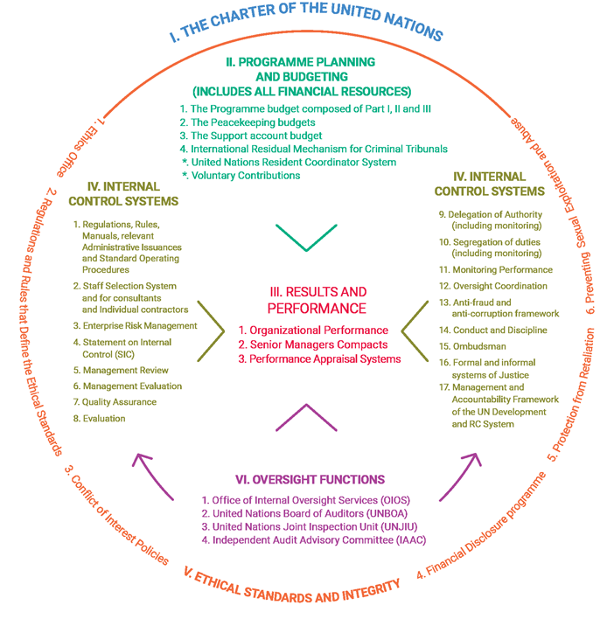
Introduction to accountability scenarios
Each of the six components represents a vital element of accountability. Together, they constitute a system to guide the processes and procedures to be executed to achieve all the results that have been mandated by Member States in full respect of the Organization’s values and policies to ensure the stewardship of resources.
Notes:
What constitutes the accountability system in the UN Secretariat and how do the six components of the system interact?
Each of the six components depicted in the figure above, represents a vital element of accountability. Together, they constitute a system to guide the processes and procedures to be executed to achieve all the results that have been mandated by Member States in full respect of the Organization’s values and policies to ensure the stewardship of resources.
The Six Components
The Charter
Foundational document of the United Nations; enshrines its basic principles, purposes, and organs.
Establishes:
That Member States issue mandates to the Secretariat, expressed as directives, priorities, and targets, and that the Secretary-General is responsible for implementing those mandates and for reporting on outcomes and the resources used.
How staff members are expected to perform i.e., competence and efficiency are defined as attributes of an International Civil Servant.
The Programme Planning and Budget documents
Reflect the mandates of Member States, the resources provided by the General Assembly to implement these mandates and represent the commitment of the Secretariat to implement those mandates and to use approved resources responsibly.
The mandates of Member States are derived from the Charter.
The General Assembly considers and approves the United Nations budget and establishes the financial assessments of Member States. The budgets are of different types and include:
Programme Budget
Peacekeeping Budgets and
Budget for the International Residual Mechanism for Criminal Tribunals
The financing of the UN programmes and operations is done through assessed and voluntary contributions made by Member States.
The Internal Control System
Represents the different mechanisms and policy framework that exists in the Organization to ensure that the Organization’s objectives and results are being achieved - and its activities implemented - in compliance with the established regulatory framework and reported to its governing bodies.
Internal control systems include:
The Regulations, Rules and Policies,
Critical Organizational Management Principles.
The Compliance Mechanisms
Results and Performance
Refer to the obligation of the Organization to deliver as expected and reflected in the budget documents and to report accurately on those results to Member States and other stakeholders.
To ensure the full alignment of what the Member States expect the Organization to achieve with the day-to-day work of individual staff members, the workplans of senior leaders and individual staff members are required to be prepared in alignment with the results established in the approved budgets.
These results are reflected as:
Organizational Performance e.g., reports on results included in the Programme Budget, peacekeeping missions’ budget and the Comprehensive Performance Assessment System (CPAS); support account budget and reports provided to donors for voluntary contributions, etc.
Individual Performance e.g., as reflected in Senior Managers’ Compacts and in e-Pas. The Secretariat also has a system of rewards, remedial action, and sanctions for poor performance or to take corrective actions if necessary.
Ethical standards and integrity
The concept of integrity embraces all aspects of our behaviour i.e., honesty, truthfulness, impartiality, incorruptibility, tolerance, and respect for all persons equally, without any distinction whatsoever.
Refer to the principles enshrined in the UN Charter, which establishes that the paramount consideration in the employment of the staff and in the determination of the conditions of service shall be the necessity of securing the highest standards of efficiency, competence, and integrity; and those embedded in the Staff Regulations and Rules concerning ethical staff conduct.
As UN staff members, we need to be aware of the regulations concerning ethical staff conduct, and all potential instances that can lead to conflict between our personal interests and those of the UN, including -but not limited to- the ones established in the Staff Regulations and Rules of the United Nations (ST/SGB/2018/1:
Regulation 1.2 - Basic rights and obligations of staff,
Regulation 1.3 - Performance of staff, and
Rules 1.1 – 1.9.
The oversight functions
In addition to Member States, that oversee the functioning of the UN through the intergovernmental organs, the oversight functions provide independent assurance on:
the stewardship of the organization’s resources,
the achievement of results
the level of compliance with the regulations, rules and policies and deter mismanagement and corruption.
A well-structured internal and external oversight function provides critical assurance on the results the Organization has achieved and on the effectiveness of the internal controls the Organization has deployed.
The oversight functions are both external and internal to the organization and consist of:
United Nations Board of Auditors (BOA).
Joint Inspection Unit (JIU).
Independent Audit Advisory Committee (IAAC).
Office of Internal Oversight Services (OIOS).
The former three are external and the fourth is internal to the Organization.

Slide 11



Introduction to accountability scenarios
In response to the increased level of risks faced by the Organization and to support the more decentralized structure brought about by the management reforms, the Organization has defined various risk management and control functions at three different levels to ensure a more effective accountability system.
The “Three Lines Model” helps organizations identify structures and processes that best assist the achievement of objectives and facilitate strong governance and risk management.
Notes:
The three lines model
In response to the increased level of risks faced by the Organization and to support the more decentralized structure brought about by the management reforms, the Organization has defined various risk management and control functions at three different levels to ensure a more effective accountability system.
The “Three Lines Model” defined by the Institute of Internal Auditors - and adopted by the Chief Executives Board (CEB) - helps organizations identify structures and processes that best assist the achievement of objectives and facilitate strong governance and risk management.
The first line role comprises the operational managers e.g., Requisitioners, the Certifying Officers and the Procurement Officers, whose functions are owning and managing the risks they might face in implementing the activities they must undertake to achieve the results they are responsible for. They must also monitor these activities and take corrective actions to address process and control deficiencies.
The second line role comprises central management functions, e.g., Committees on Contracts, Review Committees, the Responsible Officials that shoulder the responsibility of being “process custodians or stewards” that oversee how these functions are being performed in the different entities within the Secretariat. These functions oversee the risk and internal controls and provide support and guidance in those areas. The responsibilities of the second line role also include monitoring, testing, analysing, reviewing, and reporting on matters related to the management of risks and internal controls.
The third line includes functions that provide independent assurances, such as those conducted by OIOS.

Slide 12


Scenario 1: A decision taken in the best interest of the organization turned wrong
Michael works in a United Nations office in Country X, as the technical coordinator of a business transformation project.
In his current role, he is valued for his technical expertise and is responsible for the project implementation with eight staff members under his supervision. In addition, there are twenty consultants who work for the company, Future Development Projects Incorporated (FDPI), which is providing services to the project. FDPI is a well reputed consulting firm, whose services have been retained by the United Nations to design some of the processes that were to be re-configured in the context of the project, following the principle of “best value for money.”
Page 1 of 3
Notes:
Michael works in a United Nations office in Country X, as the technical coordinator of a business transformation project.
In his current role, he is valued for his technical expertise and is responsible for the project implementation with eight staff members under his supervision. In addition, there are twenty consultants who work for the company, Future Development Projects Incorporated (FDPI), which is providing services to the project. FDPI is a well reputed consulting firm, whose services have been retained by the United Nations to design some of the processes that were to be re-configured in the context of the project, following the principle of “best value for money.”

Slide 13
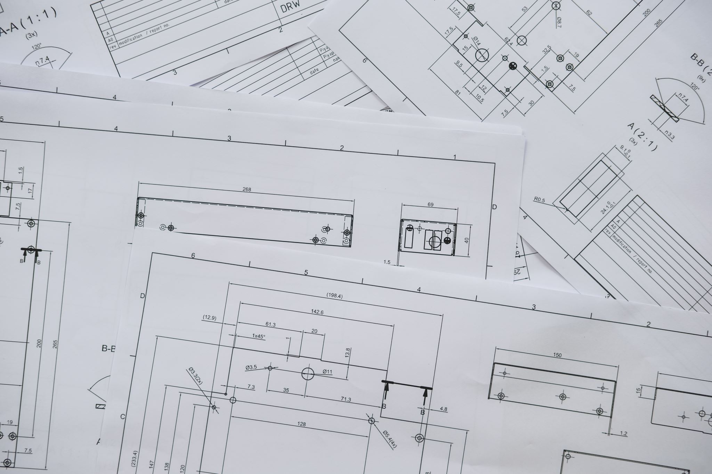
As the blueprints of the business transformation begin to take shape, Michael learns that the renovation work for the UN offices in Country X are scheduled to begin in two weeks’ time. The staff are to be relocated to temporary premises. When informed about the situation, FDPI graciously offers Michael to temporarily relocate his team in FDPI’s premises at no cost to the UN.
In the opinion of FDPI, the temporary relocation of Michael’s team into FDPI’s office premises is not only going to save financial resources for the United Nations in the form of rental expense, but will also increase the project’s efficiency, due to closer interaction of UN staff with the rest of FDPI’s personnel. This would help facilitate the transfer of knowledge between FDPI and the UN staff and expedite the learning process.
Page 2 of 3
Notes:
As the blueprints of the business transformation begin to take shape, Michael learns that the renovation work for the UN offices in Country X are scheduled to begin in two weeks’ time. The staff are to be relocated to temporary premises. When informed about the situation, FDPI graciously offers Michael to temporarily relocate his team in FDPI’s premises at no cost to the UN.
In the opinion of FDPI, the temporary relocation of Michael’s team into FDPI’s office premises is not only going to save financial resources for the United Nations in the form of rental expense, but will also increase the project’s efficiency, due to closer interaction of UN staff with the rest of FDPI’s personnel. This would help facilitate the transfer of knowledge between FDPI and the UN staff and expedite the learning process.

Slide 14

When asked by his staff what the working arrangement would be, Michael assured them that they would be comfortably located in a decent setting. He would take full responsibility for the essential facilities his team should have. Michael felt that the project had to be delivered on time, as he had a reputation for meeting his deadlines. He said that they should not let the renovation stand in the way of its the timely completion of the project.
Michael - convinced that this offer by FDPI is in the best interest of the UN and the project- decides to accept the offer. He and his team relocate temporarily to FDPI’s premises with the assistance of a moving company, hired by FDPI. Three months later, once the renovation is complete, the team moves back to the United Nations premises.
One year later, Michael is the subject of a UN investigation that determines that although he acted in good faith, the actions taken by him were not compatible with United Nations regulations, rules, and policies.
Page 3 of 3
Notes:
When asked by his staff what the working arrangement would be, Michael assured them that they would be comfortably located in a decent setting. He would take full responsibility for the essential facilities his team should have. Michael felt that the project had to be delivered on time, as he had a reputation for meeting his deadlines. He said that they should not let the renovation stand in the way of its the timely completion of the project.
Michael - convinced that this offer by FDPI is in the best interest of the UN and the project- decides to accept the offer. He and his team relocate temporarily to FDPI’s premises with the assistance of a moving company, hired by FDPI. Three months later, once the renovation is complete, the team moves back to the United Nations premises.
One year later, Michael is the subject of a UN investigation that determines that although he acted in good faith, the actions taken by him were not compatible with United Nations regulations, rules, and policies.

Slide 15


Scenario 1: discussion
Please participate fully in the discussion
No lecturing allowed
There are no perfect answers, what matters is interaction
Notes:
Discussion Question
Follow Up Questions
Important Points
What is happening in this scenario? What are the relevant facts?
What Accountability issues can you identify in this scenario?
What do you think about the offer made by the consulting firm?
What do you think of the free office space?
Would it lead to more interaction with the consulting’s firm staff?
Would it Increase knowledge transfer?
Can we locate UN staff wherever we decide?
Know your office/division’s functional areas and your responsibilities and act accordingly.
Accepting premises and the relocation of staff on behalf of the UN at "no cost" follows a different process that involves the Head of Entity and consultation with the Office of Legal Affairs.
Understanding your functions
Do the responsibilities of a technical coordinator of a project include securing office premises?
What would you have done if you were Michael?
Who is responsible for providing office premises in the office you work?
Know the functional areas of the office/division you work for, be familiar with their responsibilities as well as your responsibilities and act accordingly.
Michael should have informed his supervisor, the Division of Administration, the Business Partners, or consulted the Ethics Office upon receiving the offer and let those offices handle the case or advise him.
Michael’s responsibilities as a technical coordinator of a project did not include securing premises that would be occupied by his staff.
Conflict of interest
Does accepting an offer of this nature from an office vendor represent a conflict of interest?
Are you familiar with the concept of conflict of interest?
Do you think there is conflict of interest when the premises and the relocation of staff were provided at no cost? Yes? No? Why?
Can you be impartial in supervising a contract of a company that has provided office space at no cost and has covered the relocation costs?
There is a conflict of interest at the Organizational level. A personal conflict of interest occurs when our private interests, such as outside relationships or financial assets, interfere—or appear to interfere—with the interests of the UN, making it difficult for us to fulfil UN duties impartially. An Organizational conflict of interest occurs when outside interests or relationships interfere – or appear to interfere – with the Organizational obligations to fulfil UN duties impartially.
Host country agreements
Can we locate a UN office in a country wherever we want?
Do you know what a host country agreement is?
Did you know that the establishment of a UN office is governed by the principle of the “host country agreement”?
Are you familiar with the obligations that govern the UN operations as per the host country agreement that exists where your office is located?
The establishment of a United Nations’ office in a country is set by an agreement between the United Nations and the host government, establishing the rights and obligations of both -and it might also cover their personnel in the country.
Where the office is located might be governed by such an agreement.

Slide 16

Scenario 1: lessons learnt
The UN has a system of internal controls to assure achievement of its objectives with adequate resource utilization and reporting requirements.
This system also includes the mechanisms and processes that exist to protect staff members from abuse in the performance of their work.
Staff members are expected to be familiar with these systems
When confronted with a decision of this nature, staff members must ask their supervisor or other experienced colleagues in the office how to proceed.
Acting in good faith, without full knowledge of the internal control system, can lead to violation of internal controls.
Notes:
The United Nations has a system of internal controls that is aimed at providing reasonable assurance regarding the achievement of its objectives with adequate resource utilization and reporting requirements.
This system also includes the mechanisms and processes that exist to protect staff members from abuse in the performance of their work and are grouped into three categories:
1) The regulations, rules, and policies;
2) Critical organizational management principles; and
3) Compliance mechanisms. (including those that ensure fairness in the workplace)
Staff members are expected to be familiar with what these systems consist of and have a general knowledge of what they cover.
When confronted with a decision of this nature, staff members must ask their supervisor or other experienced colleagues in the office how to proceed. Staff members must rest assured that they will be led to the right source of information.
Acting in good faith, without full knowledge of the internal control system, can lead to violation of internal controls that might consume staff’s time and entangle them in a review process of questioning and in some instances, investigations. (It must be added that Michael was not recommended for disciplinary action as his decisions were found to be based on the notion of taking a decision in the best interest of the Organization, but he was served with a “letter of caution” by his/her supervisor requesting him to exercise due care in discharging his functions.)

Slide 17

Scenario 1: taking action
Taking a decision in the “best interest of the Organization” while not adhering to the processes, procedures, regulations, rules, and policies may take you down a wrong path.
Know the functional areas of the office you work for, be familiar with the responsibilities of your colleagues as well as your responsibilities and act accordingly.
Be familiar with the ethical standards you are expected to adhere to, including avoiding the appearance of acting in violation of them.
Notes:
Taking a decision in the “best interest of the Organization” while not adhering to the processes, procedures, regulations, rules, and policies may take you down a wrong path.
Know the functional areas of the office you work for, be familiar with the responsibilities of your colleagues as well as your responsibilities and act accordingly.
Be familiar with the ethical standards you are expected to adhere to, including avoiding the appearance of acting in violation of them.

Slide 18


Scenario 2: Honouring our commitments and delivering results under difficult circumstances
Maria is the Director of the Division that focuses on Trade and Services, in the Department that deals with trade and development in United Nations Headquarters. She has been working with the United Nations for 10 years and was recently promoted. Upon selection, she became responsible for preparing and implementing the programme of work and the budget of her Division.
As a professional, she analysed in detail the prior programme of work of her Division. She considered new emerging issues to be included for the current year and others that should be progressively discontinued. As a deference to her departing supervisor, she maintained most of the deliverables (outputs) the Division had been producing for years, and with which her staff felt comfortable, and added new ones.
Page 1 of 3
Notes:
Maria is the Director of the Division that focuses on Trade and Services, in the Department that deals with trade and development in United Nations Headquarters. She has been working with the United Nations for 10 years and was recently promoted. Upon selection, she became responsible for preparing and implementing the programme of work and the budget of her Division.
As a professional, she analysed in detail the prior programme of work of her Division. She considered new emerging issues to be included for the current year and others that should be progressively discontinued. As a deference to her departing supervisor, she maintained most of the deliverables (outputs) the Division had been producing for years, and with which her staff felt comfortable, and added new ones.

Slide 19


During the first quarter, she was very happy with the work of the Division and how her 15 staff were handling the challenges presented by the additional workload. By coincidence, three of her staff retired or left the Division at the beginning of the second quarter. At the same time, the financial situation of the Organization worsened, due to significant delays in the payment of the assessments by Member States. The vacant posts were temporarily frozen. She could not rely on general temporary assistance funds either, as their utilization had been strictly limited. She still had to deliver the work programme that she had committed to.
“I used to enjoy this work," Maria thought, while sitting at her desk at 10:00 p.m. on a Tuesday night, depressed. Her staff had also started to complain about work pressure, although when she discussed the preparation of the Division’s work plan, they had all agreed to introducing new deliverables (outputs). They had also agreed to implement the additional work that implied keeping most of the traditional deliverables (outputs), as a transitional measure towards revamping the work plan of the Division.
Page 2 of 3
Notes:
During the first quarter, she was very happy with the work of the Division and how her 15 staff were handling the challenges presented by the additional workload. By coincidence, three of her staff retired or left the Division at the beginning of the second quarter. At the same time, the financial situation of the Organization worsened, due to significant delays in the payment of the assessments by Member States. The vacant posts were temporarily frozen. She could not rely on general temporary assistance funds either, as their utilization had been strictly limited. She still had to deliver the work programme that she had committed to.
“I used to enjoy this work," Maria thought, while sitting at her desk at 10:00 p.m. on a Tuesday night, depressed. Her staff had also started to complain about work pressure, although when she discussed the preparation of the Division’s work plan, they had all agreed to introducing new deliverables (outputs). They had also agreed to implement the additional work that implied keeping most of the traditional deliverables (outputs), as a transitional measure towards revamping the work plan of the Division.

Slide 20

No one had foreseen the critical financial situation. Maria smiled at her situation, "Here I am…I wanted to re-launch the Division’s work, including more updated deliverables. My proposal was well received and approved by Member States, but I might not be able to deliver even the traditional deliverables (outputs) with the current financial situation.”
On Friday, Maria had one of her weekly meetings with her staff, which had been put in place by the prior Director. Maria was not fond of these because they always seemed to drag on and little got accomplished. Maria was supposed to talk about the division’s work plan for 15 to 20 minutes, and she could envision all her staff sitting there, fidgeting in their seats, or looking at the floor. Even worse, the staff had used the prior meeting to complain about how the Division “needed more help to implement the work programme," a request she knew she could not deliver.
Maria was not looking forward to Friday’s meeting. She wondered if there were ways to discuss the real problems in the Division and produce real results, such as how to implement the Division’s work-plan within the limitation imposed by the financial crisis.
Page 3 of 3
Notes:
No one had foreseen the critical financial situation. Maria smiled at her situation, "Here I am…I wanted to re-launch the Division’s work, including more updated deliverables. My proposal was well received and approved by Member States, but I might not be able to deliver even the traditional deliverables (outputs) with the current financial situation.”
On Friday, Maria had one of her weekly meetings with her staff, which had been put in place by the prior Director. Maria was not fond of these because they always seemed to drag on and little got accomplished. Maria was supposed to talk about the division’s work plan for 15 to 20 minutes, and she could envision all her staff sitting there, fidgeting in their seats, or looking at the floor. Even worse, the staff had used the prior meeting to complain about how the Division “needed more help to implement the work programme," a request she knew she could not deliver.
Maria was not looking forward to Friday’s meeting. She wondered if there were ways to discuss the real problems in the Division and produce real results, such as how to implement the Division’s work-plan within the limitation imposed by the financial crisis.

Slide 21
Scenario 2: discussion
Please participate fully in the discussion
No lecturing allowed
There are no perfect answers, what matters is interaction
Notes:
Discussion Question
Follow Up Questions
Important Points
What is happening in this scenario? What are the relevant facts?
Do you recall the definition of accountability?
“Responsible for honouring our commitments”.
“Achieving objectives and high-quality results”.
“implementing and delivering on all mandates to the Secretariat”.
“in compliance with all resolutions, regulations, rules and ethical standards”
“truthful, objective, accurate and timely reporting on performance results”
What components of the Accountability System are involved?
How are these issues/accountability components reflected in the scenario?
The deliverables were included in the programme budget of the Organization that was approved by a General Assembly resolution. - their implementation represents Member States’ mandates.
These results must be reported in the organizational reports that the Secretariat presents to the General Assembly at the end of the year.
They are also part of the Senior Managers Compacts and have guided the preparation of the work plans of every individual staff member (so their achievement or not will be an important part of the senior managers’ and every individual staff member’s assessment).
The work plan must be implemented in full compliance with United Nations regulations, rules, and policies (the temporary “hiring freeze” must be respected).
Decisions pertaining to this issue must be taken in compliance with the United Nations ethical standards and integrity.
The achievement of the results of the Division’s work plan might be assessed independently by the oversight bodies and must be reported to the General Assembly.
------------------------------------------------------------------------------------
What issues would you raise in this meeting if you were Maria?
What strategy could you use to solve this issue?
What process should be followed to address this problem?
Maria must be expected to show the following leadership qualities:
Maria and other managers should serve as role models that other people want to follow. (They must take responsibility for the situation and set the “tone at the top”.
The Division must reformulate the work plan, develop strategies to prioritize and accomplish its objectives.
Maria should try to convince the team to embrace the reformulated work-plan and empower the team members to translate the vision into results (A participatory approach would be useful in devising the solutions.)
The Division must drive for change and improvement, not accepting the status quo (e.g., insisting on implementing the new deliverables as part of the reformulated work-plan.)
The Division must show the courage to take an unpopular stance (e.g., not requesting additional resources during financial difficulties, reformulating the work-plan according to real team capacities, postponing the implementation of deliverables rather than eliminating them, and ensuring fairness in the distribution of the workload.)
--------------------------------------------------------------------------------
Can Maria use this meeting with her staff to solve this problem?
What should be discussed at this meeting?
Will Maria require more meetings to solve the problem?
What problems can you identify with the work plan of the Division?
Requesting additional staff is not an option in this scenario. (The Organization is facing financial constraints.)
Use the crisis to implement the expected changes.
Some of the deliverables (outputs) can be postponed, provided a good explanation is given to the oversight bodies and Member States, and individual work-plans are adjusted accordingly.
------------------------------------------------------------------------------------------
What steps should Maria take?
Present an honest “picture” to the staff of the workload the Division is facing and express willingness to take additional work herself (“tone at the top”).
Devise a strategy to re-define the workload and share the challenges:
Determine how the work is currently done and determine whether there are new, more effective ways to do it.
Hold discussions about workload and consider the possibilities of redistribution.
Assign tasks to staff according to their strengths.
Brainstorm about systems that could be put in place to scale how the work is done: Automation? Process improvements?
Adjust the work-plan of the Division according to the resources available.
Establish clear priorities, including most of the new deliverables to initiate the Division’s transition towards the preparation of deliverables (outputs) more attuned with Member States’ needs.
Once the plan has been established and embraced by the staff, she should engage constantly with the team to ensure the deliverables get implemented (e.g., monitor, give feed-back, promote open dialogue, etc.) and she should introduce a new format of the weekly meeting, if the meeting is maintained.
Share the rewards and happiness on the achievements.

Slide 22
Scenario 2: lessons learnt
Honouring the Organization’s commitments, achieving objectives and high-quality results; and implementing and delivering on all mandates to the Secretariat means doing everything possible to implement the Organization’s mandates. In this scenario:
  Maria delivered in the implementation of the work plan to the extent permitted by the resource constraints.
  Maria postponed the implementation of some deliverable outputs , those with the lowest priority and impact.
  Moreover, she did so without asking for additional resources or exceptions.
While facing her difficulties and looking for a solution, Maria showed leadership qualities that led her to address the challenges successfully.
  She was honest, showing integrity in recognizing the problem, and adjusted the Division’s work plan.
  She led by example, focusing on her staff, using a participatory approach.
Notes:
Honouring the Organization’s commitments, achieving objectives and high-quality results; and implementing and delivering on all mandates to the Secretariat means doing everything possible to implement the Organization’s mandates. In this scenario:
Maria delivered in the implementation of the work plan to the extent permitted by the resource constraints.
Maria did not complete all the deliverable outputs she had committed the Division to implement. She postponed the implementation of some, those with the lowest priority and impact, for the following year.
Moreover, she did so without asking for additional resources -- which have shifted by a hiring freeze temporarily imposed by the financial situation being faced by the Organization -- or exceptions.
While facing her difficulties and looking for a solution, Maria showed leadership qualities that led her to address the challenges successfully.
She was honest, showing integrity in recognizing the problem, and adjusted the Division’s work plan.
She led by example, focusing on her staff, using a participatory approach. She understood the value of listening (e.g., leadership is about people), maintained her focus on change, and worked together with her team to achieve more.

Slide 23
Scenario 2: taking action
Serve as role models that other people want to follow.
Be ready to reformulate work plans and develop strategies to accomplish objectives.
Work with and empower others to translate visions into results.
Drive for change and improvement.
Show the courage to take unpopular stands.
Notes:
Serve as role models that other people want to follow.
Be ready to reformulate work plans and develop strategies to accomplish objectives.
Work with and empower others to translate visions into results.
Drive for change and improvement.
Show the courage to take unpopular stands.

Slide 24


Scenario 3: Accountability for racial bias
Sylvie is the Chief of the Africa Section in the Department responsible for social affairs, leading a team of three staff members: Mark, Wang, and Jamal.
The team is working under pressure to assess political and social developments alongside the General Assembly, other intergovernmental bodies and advising senior management on policy responses. Jamal prepares most of the briefing material to present the Africa programme in departmental meetings. But whenever Sylvie has gone to present their issues to senior management, she has taken Mark rather than Jamal. Jamal has been unhappy, feeling overlooked, but he does not know how to deal with the situation.
Six months after Jamal first noted the different treatment, an opportunity for a temporary promotion became available in another team in the Department. Jamal knew well their work because he had partnered with them numerous times before, and he applied. However, he learned that his job application was not successful. The other team’s Section Chief shared with him that Sylvie had given him a bad recommendation.
Page 1 of 4
Notes:
Sylvie is the Chief of the Africa Section in the Department responsible for social affairs, leading a team of three staff members: Mark, Wang, and Jamal.
The team is working under pressure to assess political and social developments alongside the General Assembly, other intergovernmental bodies and advising senior management on policy responses. Jamal prepares most of the briefing material to present the Africa programme in departmental meetings. But whenever Sylvie has gone to present their issues to senior management, she has taken Mark rather than Jamal. Jamal has been unhappy, feeling overlooked, but he does not know how to deal with the situation.
Six months after Jamal first noted the different treatment, an opportunity for a temporary promotion became available in another team in the Department. Jamal knew well their work because he had partnered with them numerous times before, and he applied. However, he learned that his job application was not successful. The other team’s Section Chief shared with him that Sylvie had given him a bad recommendation.

Slide 25

Upon learning this, Jamal found the courage to speak to Sylvie one-on-one about his perceptions of bias in the team and inform her of the reasons why he had wanted to move to another team. Sylvie assured Jamal that he was a valuable part of the team and contributed a lot to the Department’s work. This was so because he was the only team member of African origin who understood the nuances of Africa and its challenges.
In light of Sylvie’s confirmation of his expertise and validation of his special value to the Africa Section, Jamal further asked her why then he was not the team leader and why he was not participating in the briefings to senior management. Sylvie responded that the team leader was “just” an unimportant designation, independent of pay grade. Also, she often found Jamal’s accent in English difficult to understand, so she preferred to take Mark with her, because his “Queen’s English always commands attention.” Jamal was shocked to think that Sylvie might be stifling his career advancement, based on her subjective rating of his accent in English, and he suddenly felt that Sylvie had purposely sabotaged him. Jamal knew Sylvie’s behaviour was unacceptable and not consistent with applicable United Nations regulations and rules. He felt he could not afford to let this behaviour go unchallenged.
Page 2 of 4
Notes:
Upon learning this, Jamal found the courage to speak to Sylvie one-on-one about his perceptions of bias in the team and inform her of the reasons why he had wanted to move to another team. Sylvie assured Jamal that he was a valuable part of the team and contributed a lot to the Department’s work. This was so because he was the only team member of African origin who understood the nuances of Africa and its challenges.
In light of Sylvie’s confirmation of his expertise and validation of his special value to the Africa Section, Jamal further asked her why then he was not the team leader and why he was not participating in the briefings to senior management. Sylvie responded that the team leader was “just” an unimportant designation, independent of pay grade. Also, she often found Jamal’s accent in English difficult to understand, so she preferred to take Mark with her, because his “Queen’s English always commands attention.” Jamal was shocked to think that Sylvie might be stifling his career advancement, based on her subjective rating of his accent in English, and he suddenly felt that Sylvie had purposely sabotaged him. Jamal knew Sylvie’s behaviour was unacceptable and not consistent with applicable United Nations regulations and rules. He felt he could not afford to let this behaviour go unchallenged.

Slide 26

Jamal mustered the courage to speak to his Director and raise his perception of bias, but the Director told Jamal to “lighten up” and that it was unfair to make such strong allegations of racial prejudice against his supervisor. Jamal then sought the advice of the Office of the Ombudsman and Mediation Services in the face of Sylvie’s seeming racial discrimination and alleged abuse of authority. While the Office of the Ombudsman explained that they could not get involved in formal accountability matters, they helped him evaluate his options, including a mediation between Jamal and Sylvie. After discussing the option with a colleague, Jamal declined the offer, as he felt it was undignified to enter mediation with a person whom he considered to be a racist. While re-affirming that the choice was Jamal’s, the Office of the Ombudsman explained that ensuring accountability could occur through both formal and informal means even if the processes employed by each were quite different. The Ombudsman’s Office emphasized that choosing the most appropriate path depended upon the situation and the preferences of the person making the decision.
Page 3 of 4
Notes:
Jamal mustered the courage to speak to his Director and raise his perception of bias, but the Director told Jamal to “lighten up” and that it was unfair to make such strong allegations of racial prejudice against his supervisor. Jamal then sought the advice of the Office of the Ombudsman and Mediation Services in the face of Sylvie’s seeming racial discrimination and alleged abuse of authority. While the Office of the Ombudsman explained that they could not get involved in formal accountability matters, they helped him evaluate his options, including a mediation between Jamal and Sylvie. After discussing the option with a colleague, Jamal declined the offer, as he felt it was undignified to enter into mediation with a person whom he considered to be a racist. While re-affirming that the choice was Jamal’s, the Office of the Ombudsman explained that ensuring accountability could occur through both formal and informal means even if the processes employed by each were quite different. The Ombudsman’s Office emphasised that choosing the most appropriate path depended upon the situation and the preferences of the person making the decision.

Slide 27

When Jamal approached his staff representatives, they offered to help him file a formal complaint under ST/SGB/2019/8, though they alerted him to the risk of retaliation. He had second thoughts, fearing that standing up for his principles could put his career at risk.
Meanwhile, the mood in the team deteriorated. Jamal was increasingly withdrawn, making a point of replying only to explicit requests and not volunteering any extra information to his colleagues. Other teams and external clients soon began pointing out to Sylvie and her supervisor that the quality of the team’s work seemed to be dropping. Their submissions were often late, and factual errors were found in their coverage of African issues.
Page 4 of 4
Notes:
When Jamal approached his staff representatives, they offered to help him file a formal complaint under ST/SGB/2019/8, though they alerted him to the risk of retaliation. He had second thoughts, fearing that standing up for his principles could put his career at risk.
Meanwhile, the mood in the team deteriorated. Jamal was increasingly withdrawn, making a point of replying only to explicit requests and not volunteering any extra information to his colleagues. Other teams and external clients soon began pointing out to Sylvie and her supervisor that the quality of the team’s work seemed to be dropping. Their submissions were often late, and factual errors were found in their coverage of African issues.

Slide 28
Scenario 3: discussion
Please participate fully in the discussion
No lecturing allowed
There are no perfect answers, what matters is interaction
Notes:
Discussion Question
Follow Up Questions
Important Points
What is happening in this scenario? What are the relevant facts?
What accountability issues are at play in the actions of the following individuals (you may refer to the “6 Components” for guidance):
Sylvie
Jamal
The Director
Sylvie: Integrity (impartiality, tolerance, respect for all persons), staff selection, quality assurance, monitoring performance, performance appraisal, conduct and discipline.
Jamal: Integrity (competence and efficiency), performance appraisal (professionalism).
The Director: Integrity (competence), risk management (first line of defence), monitoring delegation of authority, informal system of justice
Rewards and appraisal
How do Sylvie’s actions not show recognition of Jamal’s contributions?
Does the UN appraisal system contain a rewards system for well-performing staff?
What measures should have been taken to recognize Jamal’s contributions?
Have Sylvie’s actions fallen short of any core values and competencies required of a manager?
What performance evaluation measures are available to address Sylvie’s actions?
Should Jamal’s performance, resulting from his withdrawal, be addressed in the context of an ePas?
Except for within-grade increments, no rewards are available for the recognition of good performing staff.
This situation notwithstanding, performance evaluations (ePas), delegation of responsibilities and authorities, and, to an extent, the staff selection system can be used to recognize good performance.
Managers are required to display respect for diversity, integrity, professionalism, empowering others, building trust, leadership, managing performance and judgment.
Managers’ performance can be evaluated through ePas or 360 reviews.
Staff members are required to display professionalism even when faced with stressful situations and are required to be motivated by professional rather than personal concerns. This notwithstanding, supervisors are required to be fair and equitable when addressing underperformance.
Channels for redress
What options does Jamal have for addressing what he perceives to be Sylvie’s racial bias?
Was the Director’s response satisfactory? Where does the Director fall in the “Three Lines Model”? What should he have done?
Was Jamal’s response to the Ombudsman appropriate?
What formal channels can Jamal pursue within the system to hold Sylvie accountable for her racial bias?
Under the Three Lines Model, the Director would fall under the first line of defence. His role is to monitor and take corrective action by facilitating mediation between Jamal and Sylvie or advising Jamal of informal and formal processes for addressing prohibited conduct.
While staff members are encouraged to discuss their situation with the Ombudsman and Staff Counsellors, informal resolution, including through the Ombudsman, is voluntary.
Formal reports of prohibited conduct may be addressed to the Head of Entity, with copy to OIOS or to OIOS directly.
Recruitment decisions may be challenged before the Management Evaluation Unit.
Remedies and sanctions
What remedies and protections are available to Jamal for his situation?
Would an informal remedy (i.e., a mutually agreed mediated solution) be appropriate in the circumstances?
Is Sylvie accountable (liable to any sanctions) for her conduct?
What remedies are available to address Jamal’s fear of retaliation?
Complainants of racial bias may access different remedies depending on the specific facts of the case, such as (i) a fact-finding investigation to address racially hostile conduct, (ii) a negotiated solution following mediation, and/or (iii) compensation or a rescission of a recruitment decision based on racial bias through the UN Dispute Tribunal.
If Sylvie’s actions constitute unsatisfactory or prohibited conduct, she might (i) be disciplined following a formal report of prohibited conduct, (ii) receive negative ratings through her ePas, or (iii) sent for training on respecting diversity -- depending on the outcome of a fact-finding activity.
Staff members who experience retaliation for reporting misconduct may contact the Ethics Office for a review of their claim and recommendations for protection. Heads of Entity may take interim measures for preventing retaliation against staff members who report misconduct and fear retaliation. The OIOS may report risk of retaliation to the Ethics Office for preventive action.

Slide 29
Scenario 3: lessons learnt
Managers are required to demonstrate United Nations core values and competencies, including respect for diversity. Racial bias in managing staff displays a lack of several United Nations values.
Managers can be held accountable for racial bias through the performance evaluation system as well as through the disciplinary process.
Staff members complaining of experiencing racial bias from their supervisors may resort to formal and informal channels for a solution.
Second level managers who are notified of racial bias incidents among their supervisees have a duty to advise the complainant of the channels of redress.
Notes:
Managers are required to demonstrate United Nations core values and competencies, including respect for diversity. Racial bias in managing staff displays a lack of several United Nations values.
Managers can be held accountable for racial bias through the performance evaluation system as well as through the disciplinary process.
Staff members complaining of experiencing racial bias from their supervisors may resort to formal and informal channels for a solution as well as be negatively impacted in terms of their health and well-being.
Second level managers who are notified of racial bias incidents among their supervisees have a duty to advise the complainant of the channels of redress.

Slide 30
Scenario 3: taking action
Report misconduct, including racial bias, to the appropriate formal and informal channels.
Report retaliation for reporting misconduct to the Ethics Office.
Managers should take complaints of racial bias seriously and respond to them appropriately.
Notes:
Report misconduct, including racial bias, to the appropriate formal and informal channels.
Report retaliation for reporting misconduct to the Ethics Office.
Managers should take complaints of racial bias seriously and respond to them appropriately.

Slide 31
In conclusion
Each of us plays a role in the Accountability System in the United Nations Secretariat to support United Nations ideals and fulfil our mission.
If there is an issue you did not feel comfortable talking about in front of others, please
    speak to session leader OR
    Business Transformation and Accountability Division, DMSPC OR
    Ethics Office
You may also consult The Roadmap, published by the Ethics Office, which is a guide for those seeking assistance. Feel free to consult the Office’s website for a copy.
Notes:
That was an excellent discussion. You made very interesting points.
Each of us plays a role in the Accountability System in the United Nations Secretariat to support United Nations ideals and fulfil our mission.
As we discussed today, if there is an issue you did not feel comfortable talking about in front of others, please speak to me after this session.
If you are not comfortable speaking to me, there are a variety of other resources including the following:
Business Transformation and Accountability Division, DMSPC
Ethics Office
The Roadmap, published by the Ethics Office, is a guide for those seeking assistance. Feel free to consult the Office’s website for a copy.

Slide 32
Before you go …
For more information, or to comment, contact:
United Nations Ethics Office
www.un.org/en/ethics
(Available via iSeek or the public United Nations site)
Email : ethicsoffice@un.org
Phone +1-917-367-9858
Fax +1-917-367-9861
Also, please consult these resources, available on our website:
Putting Ethics to Work: A Guide for UN Staff
The Roadmap: A Staff Member’s Guide to Finding the Right Place
Notes:
Thank you for your participation today.
I hope you found it useful.
I appreciated your enthusiasm for the discussion and your ideas and comments.
Before we close the session, are there any final questions or comments?

